Slide 1
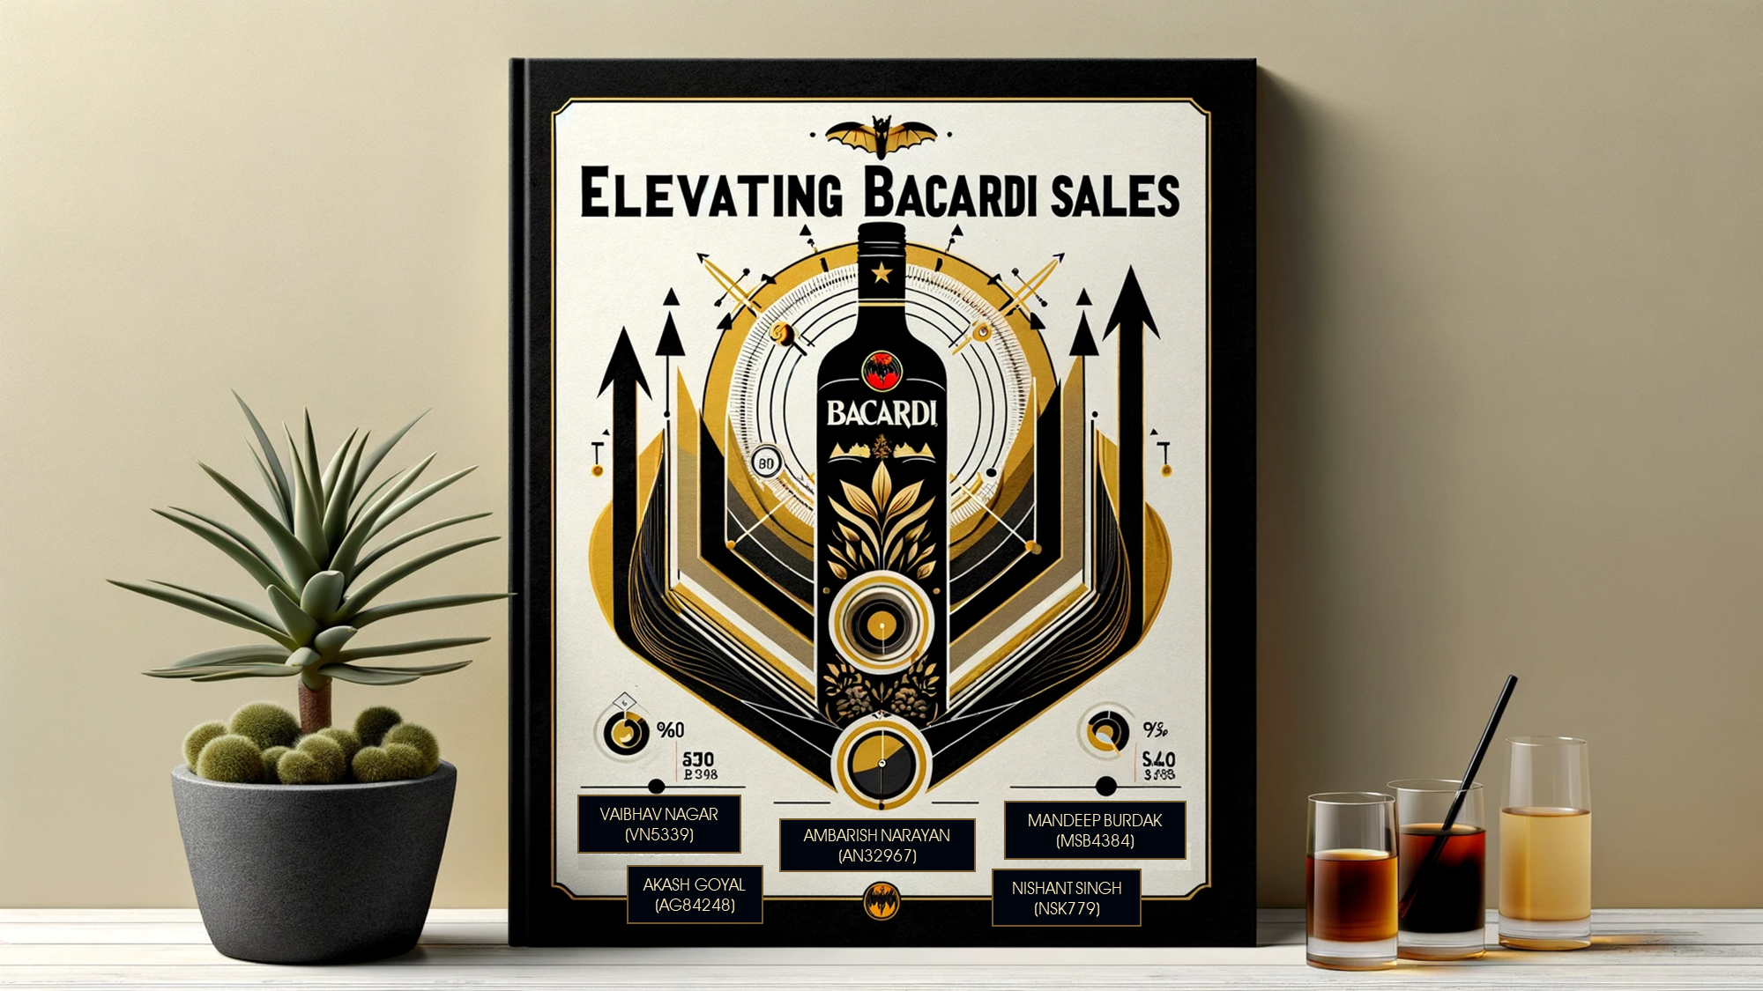
Marketing Analytics: All about Alcohol
Akash Goyal (ag84248)
Mandeep Burdak (msb4384)
Nishant Singh (nsk779)
Ambarish Narayan(an32967)
Vaibhav Nagar (vn5339)

Slide 2
Table of Contents
1
4
Project Objectives
Mix Optimization
Brief about the objectives and Questions to Answer
Optimal Sales Promotion and Discount
2
5
Market Context
Summary & Recommendations
A description of Market Context
Key learnings and insights
3
Competition
Identifying Key Competitor in Category

Slide 3

PROJECT
OVERVIEW

Slide 4

Project Objectives and Questions
How do we identify our closest competitor?
1
Where do we boost sales for our brand?
2
How do we promote our brand to earn more?
3

Slide 5
MARKET
OVERVIEW

Slide 6
Bacardi experiences negative YoY growth and decrease in market share
Brand share of sales
Brand Sales Growth
Brands
Market Share (%)
AP
Brands
YoY Growth (%)
Δ Share%
DIAGEO AMERICAS
$26
$14
$19
$20
$25
$12
$28
$34
$9
$18
$19
$50
$30
$31
$30
$9
$11
$53
$34
$26
DIAGEO AMERICAS
-0.1%
0.8%
0.6%
-0.6%
0.1%
0.0%
-0.3%
0.0%
-0.1%
0.0%
-0.1%
-0.4%
0.0%
0.1%
0.3%
0.1%
-0.1%
-0.3%
0.0%
-0.1%
SAZERAC COMPANY
SAZERAC COMPANY
FIFTH GENERATION
FIFTH GENERATION
JIM BEAM
JIM BEAM
PERNOD RICARD
PERNOD RICARD
HEAVEN HILL
HEAVEN HILL
BACARDI
BACARDI
BROWN FORMAN
BROWN FORMAN
LUXCO
LUXCO
PROXIMO
PROXIMO
E & J GALLO
E & J GALLO
MOET HENNESSY
MOET HENNESSY
MAST-JAGERMEISTER
MAST-JAGERMEISTER
CAMPARI AMERICA
CAMPARI AMERICA
OLE SMOKY
OLE SMOKY
MCCORMICK
MCCORMICK
PHILLIPS
PHILLIPS
REMY COINTREAU
REMY COINTREAU
WILLIAM GRANT & SONS
WILLIAM GRANT & SONS
Source: data.iowa.gov: 2023-2022 (YTD)
Overall Market AP : $19, YoY = 5%
Please note: 1) AP = Average Price per Litres (2023) 2) YoY% = 2023 (Oct) vs 2022(Oct)

Slide 7
Sales Value vs Sales Volume Growth indicates how brands are positioned compared to the overall market
Volume Growth(%)
113
Avg Market Value Growth = 5%
112
FIFTH GENERATION
111
110
109
Comments & Insights:
Growing Brands: Fifth Generation and Sazerac are growing above market pace
Market: The market is growing in both value and volume
Bacardi: Our brand is growing below market pace both in terms of value and volume
108
107
106
105
BROWN FORMAN
104
SAZERAC COMPANY
103
102
Avg Market Volume Growth = 102%
101
HEAVEN HILL
100
PERNOD RICARD
99
DIAGEO AMERICAS
98
BACARDI
97
96
PROXIMO
95
LUXCO
Market share loss
94
JIM BEAM
Market share gain
0
Source: data.iowa.gov: 2023-2022 (YTD)
Value Growth(%)
Please note: We have used just the top 10 brands here using sales(2023)
Size = Sales (in Dollars)

Slide 8
COMPETITOR ANALYSIS

Slide 9
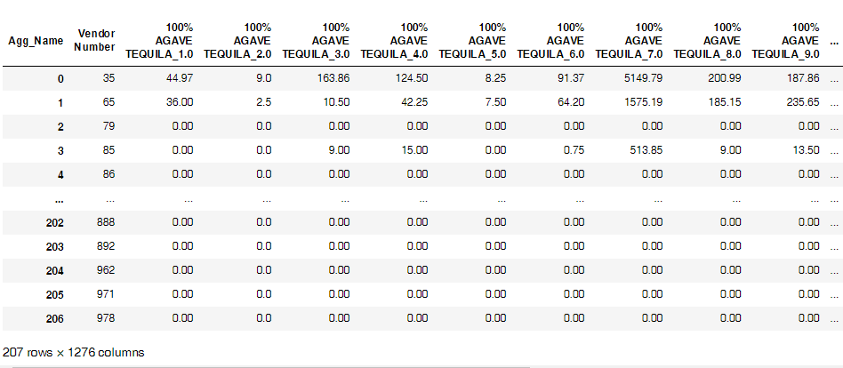
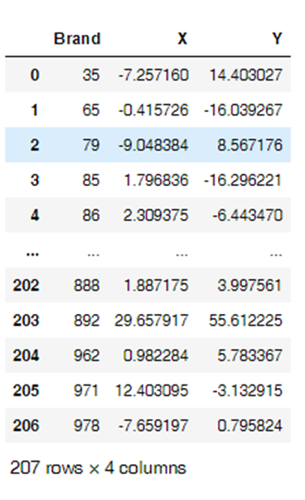
T-SNE: Reducing sales across categories and counties to 2 columns
>> T-SNE reduces data dimensions to 2 columns for scaling, but 'X' and 'Y' values lack inherent meaning beyond their relative positions, emphasizing visualization over direct interpretability."
Source: data.iowa.gov - FY’ 2022
Each column is the FY22 sales of the vendor across different categories and counties.

Slide 10
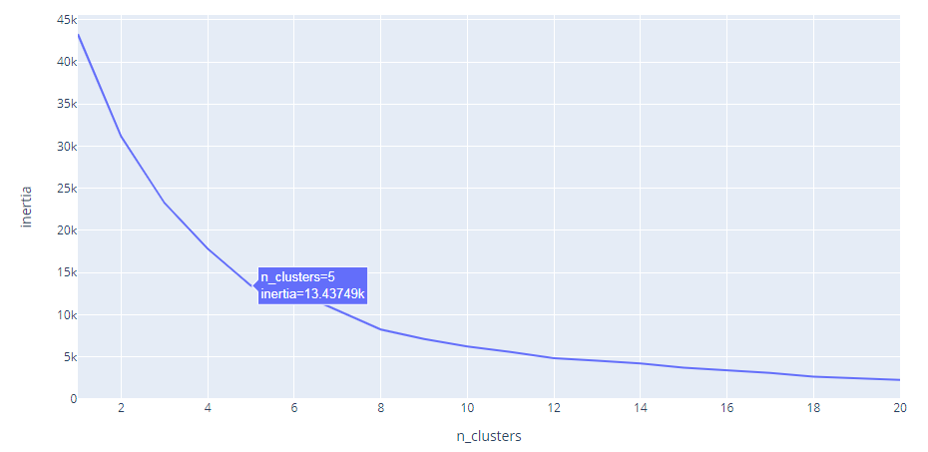
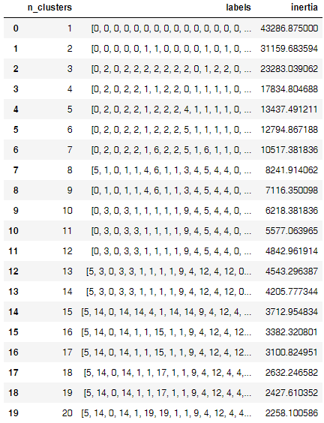
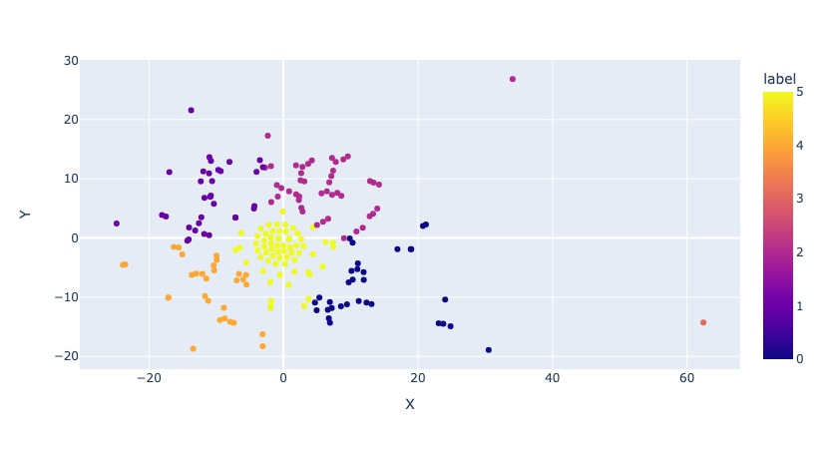
Cluster Analysis: Identified Luxco as the closest competitor for Bacardi
Identifying optimal number of clusters (Elbow at n=5)
Visualizing the clusters identified from the above plot
Bacardi and Luxco as relevant competitor
Source: data.iowa.gov - FY’ 2022

Slide 11
Category Deep Dive: Bacardi has good sales opportunities in the Gold Rum
Category | Luxco | Bacardi | Sales Difference (Volume)
IMPORTED DISTILLED SPIRITS SPECIALTY | 99,950 | 971 | -98,980
GOLD RUM | 46,334 | 32,097 | -14,236
STRAIGHT BOURBON WHISKIES | 41,865 | 11,099 | -30,765
NEUTRAL GRAIN SPIRITS | 26,615 | 4,227 | -22,388
AMERICAN FLAVORED VODKA | 20,665 | 7 | -20,658
SPICED RUM | 15,953 | 3,677 | -12,276
IRISH WHISKIES | 1,584 | 1,524 | -60
SPECIAL ORDER ITEMS | 485 | 32 | -453
Comments & Insights:
Both Gold Rum and Imported Spirits have promising opportunities for Bacardi
Gold Rum is a good pick for category as it is more actionable to boost sales
Among the two Gold Rum has sufficient sales and is comparatively easier to push
Volume Difference is higher for Distilled Spirits, Bourbon Whiskies, grain spirits and Vodka but Bacardi’s volume sales are not significant enough and it will be too ambitious to drive volume here.
Hence, Gold Rum is the best pick here
Source: data.iowa.gov - FY’ 2022

Slide 12
MIX OPTIMIZATION

Slide 13
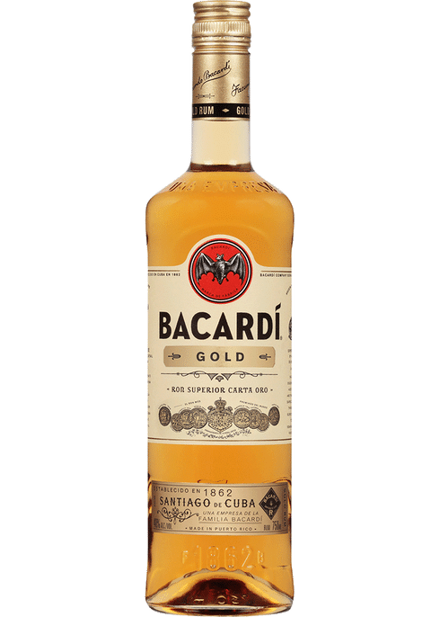
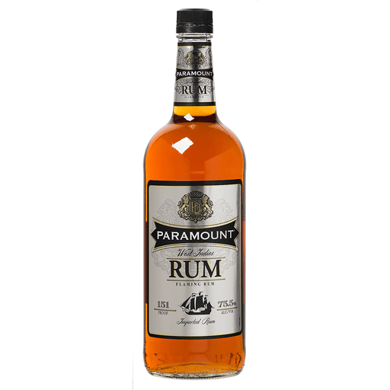

Our Playing Field
VS
Bacardi
Luxco

Slide 14
Discount pricing seems like a good strategy that can help Bacardi Gold gain volume sales
Brand | Sales (Dollar) | Share
Bacardi Gold | 5,07,069 | 49%
Luxco (Paramount Gold) | 3,09,241 | 30%
Others | 2,12,026 | 21%
Comments & Insights:
Bacardi Gold has a higher selling price than Luxco, hence Bacardi Gold has ~49% value share vs 30% for Paramount Gold while 37% volume share vs 53% for Paramount
An increase in volume sales can significantly strengthen Bacardi’s position in the market
Since Bacardi Gold has a higher selling price a discount pricing strategy might help us in acquiring more market share
Brand | Sales (Volume) | Share
Bacardi Gold | 32,097 | 37%
Luxco (Paramount Gold) | 46,334 | 53%
Others | 8,573 | 10%
Source: data.iowa.gov - FY’ 2022
Please note: LUXCO is same as Paramount

Slide 15
REGRESSION
MODEL

Slide 16
Predicting Volume Sold(L) : Gold Rum sales increase by approximately 29L for each $1 decrease in cost
Source | Coefficient | p values
Intercept | 347.452 | <0.0001
Cost | -28.895 | <0.0001
BACARDI GOLD | 144.762 | <0.0001
BACARDI GOLD PET | 125.432 | <0.0001
PARAMOUNT GOLD RUM | 3.655 | 0.100
PARAMOUNT GOLD PET | 0.000 | -
Bottle Volume 375 mL | -345.031 | <0.0001
Bottle Volume 750 mL | -216.265 | <0.0001
Bottle Volume 1000 mL | -204.683 | <0.0001
Bottle Volume 1750 mL | 0.000 | -
Comments & Insights:
The regression table shows a negative relationship between cost and product demand, with demand decreasing by 29 units for each unit increase in cost.
The model also reveals significant effects of brand variants and bottle volumes on demand, with larger bottles negatively impacting demand, while brand names like BACARDI GOLD positively influence it
A $1 decrease in price leads to ~29L increase in volume sales
Paramount Gold PET 1750 mL has been used as base class
‘Cost’ represents Cost to State i.e. the price at which the manufacturers sell to the State.
Source: data.iowa.gov - FY’ 2022
*Other predictors remain unchanged

Slide 17
OPTIMAL DISCOUNT AND SALES

Slide 18
Optimizing the discount using solver to maximize gain in margin
Maximizing incremental margin by optimizing the discount rate
The discounted cost leads to increased sales volume
Product | Cost | Predicted Volume (L) | Margin per Bottle | Total Margin
Bacardi Gold 375(mL) | 4.8 | 8.0 | 1.6 | 34.1
Bacardi Gold 750(mL) | 8.6 | 28.8 | 2.9 | 109.5
Bacardi Gold 1000(mL) | 9.5 | 13.0 | 3.2 | 41.3
Bacardi Gold 1750(mL) | 15.3 | 50.2 | 5.1 | 146.4
Bacardi Gold Pet 750(mL) | 8.6 | 9.4 | 2.9 | 35.9
Bacardi Gold Pet 1750(mL) | 15.3 | 29.4 | 5.1 | 86.1
Paramount Gold 750(mL) | 4.0 | 18.5 | 1.3 | 33.2
Paramount Gold 1000(mL) | 4.4 | 17.8 | 1.5 | 26.5
Paramount Gold 1750(mL) | 7.5 | 133.1 | 2.5 | 191.3
Paramount Gold Pet 750(mL) | 4.0 | 15.0 | 1.3 | 26.7
Optimal Discount
0.67
0.93
1.36
1.68
1.26
2.05
-
-
-
-
Cost | Predicted Volume (L) | Margin per Bottle | Total Margin
4.2 | 27.2 | 0.9 | 68.2
7.6 | 55.6 | 1.9 | 142.6
8.1 | 52.3 | 1.8 | 94.5
13.6 | 98.8 | 3.4 | 193.0
7.3 | 45.9 | 1.6 | 97.3
13.3 | 88.6 | 3.1 | 155.3
4.0 | 18.5 | 1.3 | 33.2
4.4 | 17.8 | 1.5 | 26.5
7.5 | 133.1 | 2.5 | 191.3
4.0 | 15.0 | 1.3 | 26.7
Source: data.iowa.gov - FY’2022
*Assuming same margin for manufacture as the State margin=33%

Slide 19
Results: After applying the optimal discount, the margin per bottle may decrease, but it ultimately results in a 66% increase in margin as volume rises
Source: data.iowa.gov - FY’2022

Slide 20
SUMMARY & RECOMMENDATIONS

Slide 21

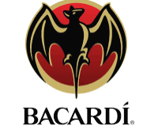
Summary and Recommendation
How do we identify our closest competitor?
Luxco is the swift rival, racing alongside us across diverse domains in every realm
Where do we boost sales for our brand?
Gold Rum is the gleaming treasure chest that houses our spirits, a fruit ripe for the taking
How do we promote our brand to earn more?
Our competitor is the thrifty whisperer of slim profits and vast quantities, while we possess the space to unveil discounts and expand our horizons
Recommendation: We recommend moving forward with the optimal discounts to boost margins. Given that we have further access to Bacardi's data, we can conduct A/B testing on actual data to validate our analyses

Slide 22
That’s all folks.
Cheers!!!

Slide 23
Appendix

Slide 24
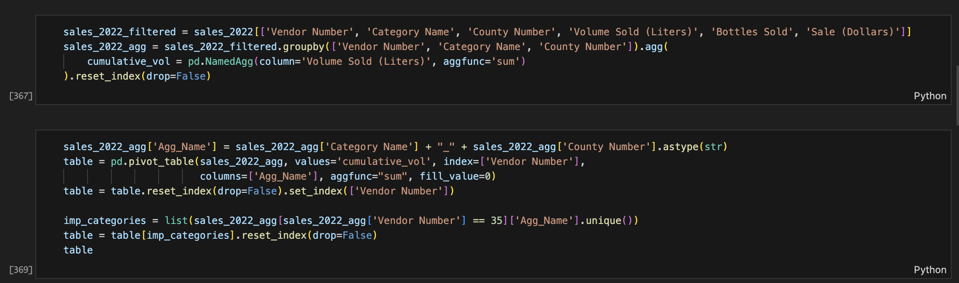
tSNE & Data Prep

Slide 25
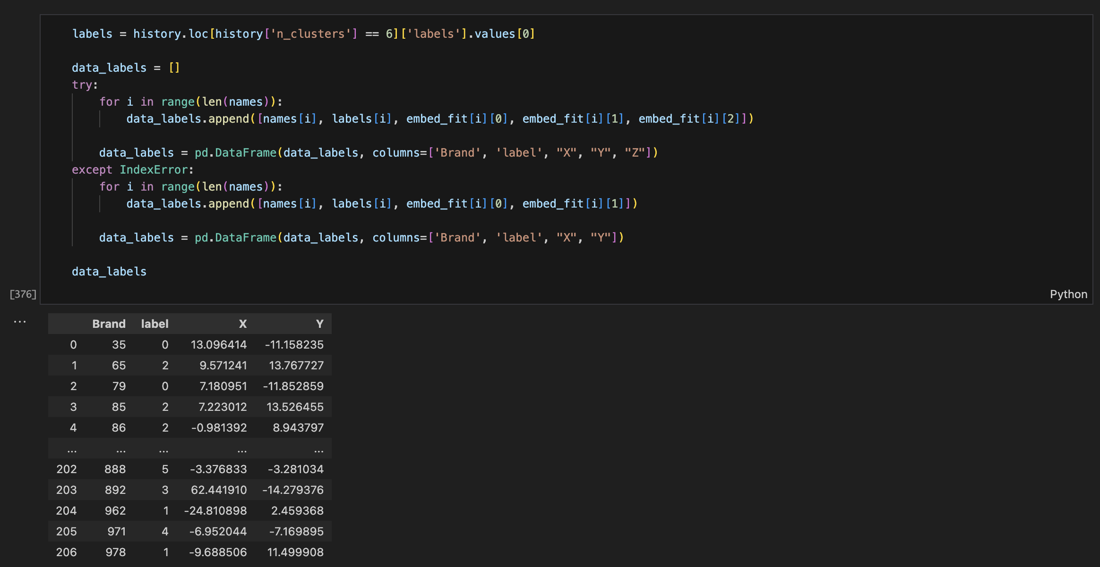
K Means Clustering

Slide 26
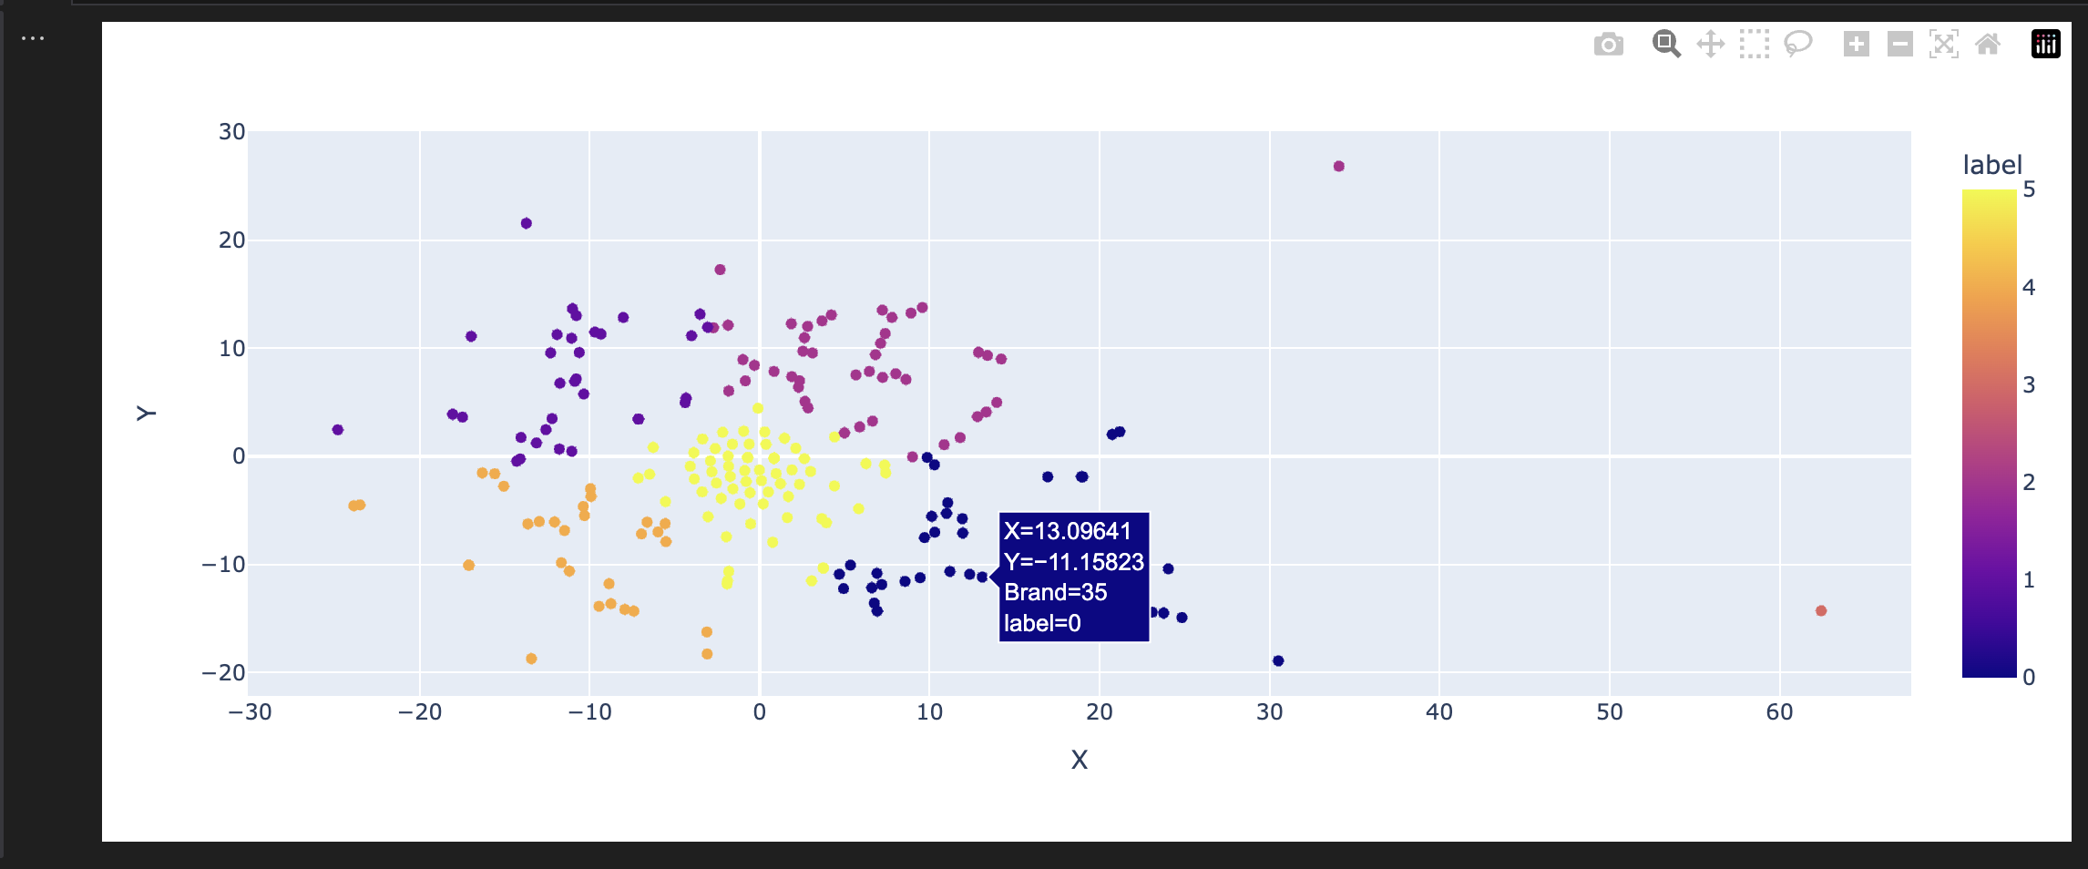
Bacardi Vendor 35

Slide 27
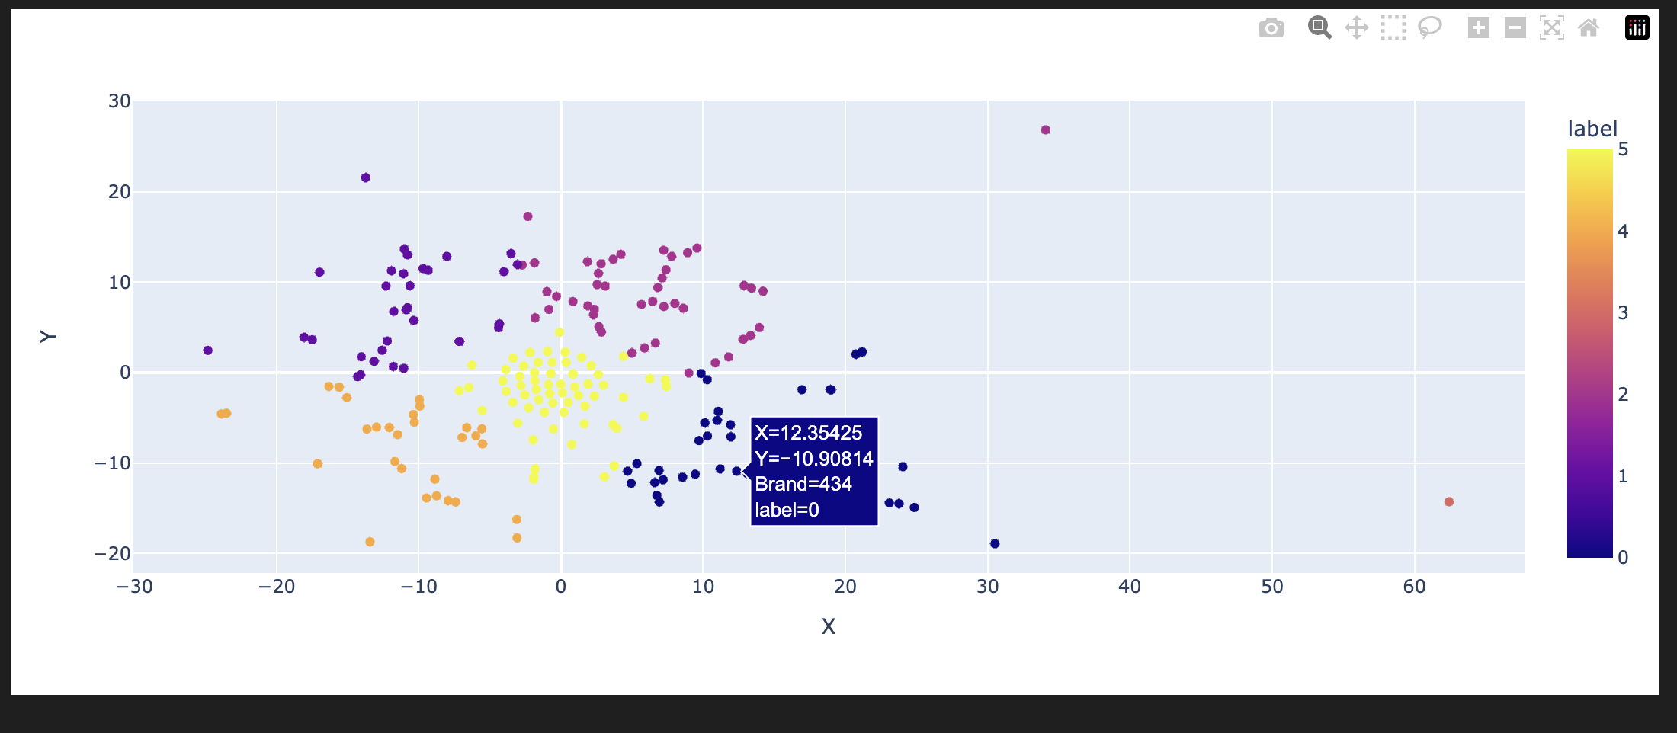
Luxco Vendor 434

Slide 28
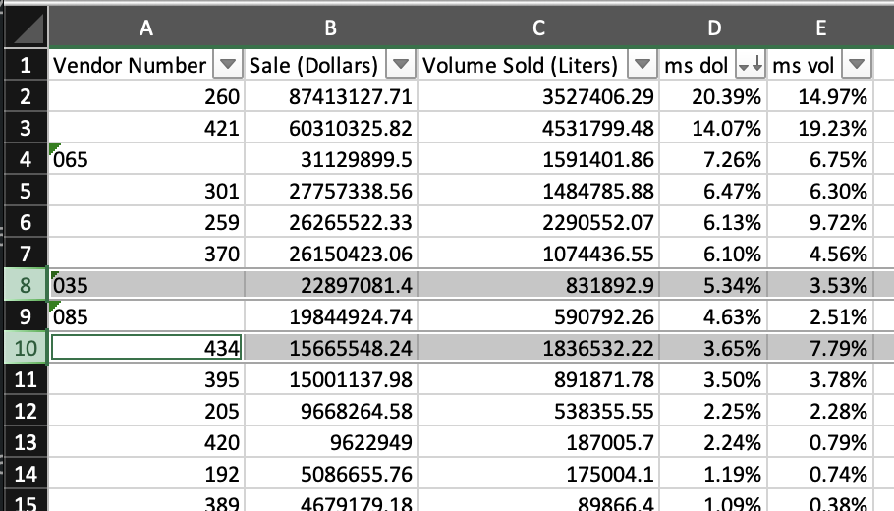
Overall Market Share

Slide 29
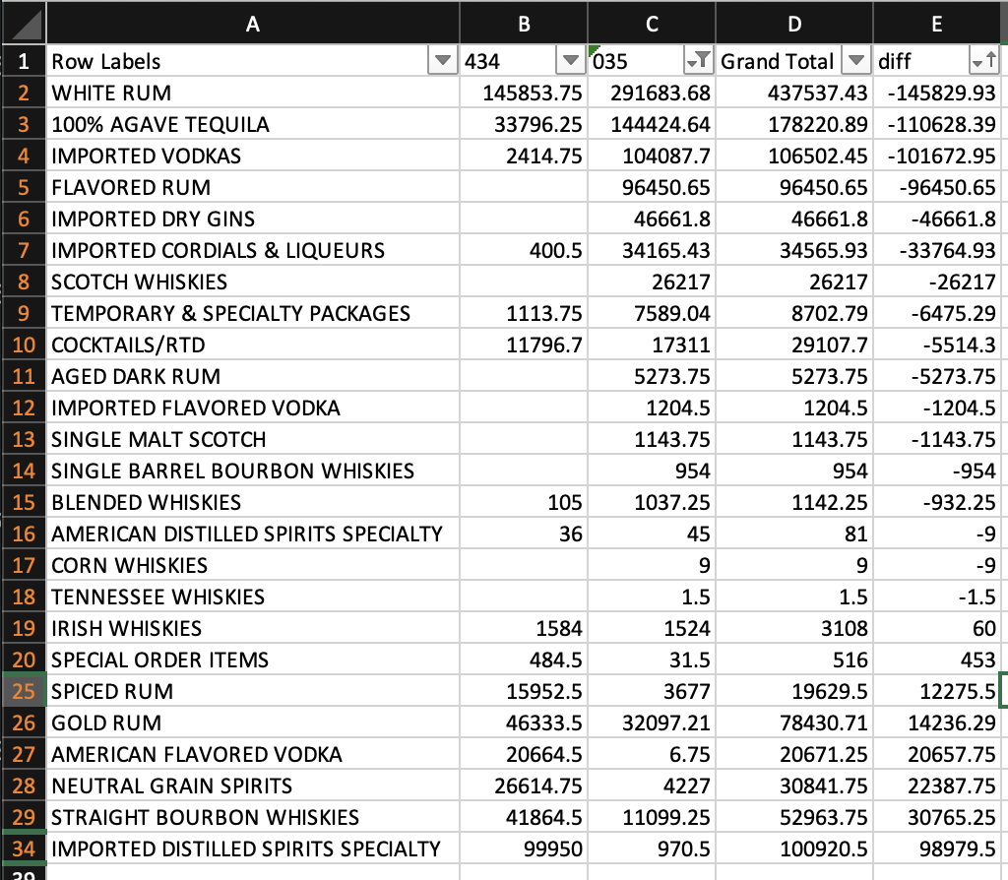
Category wise Sales

Slide 30
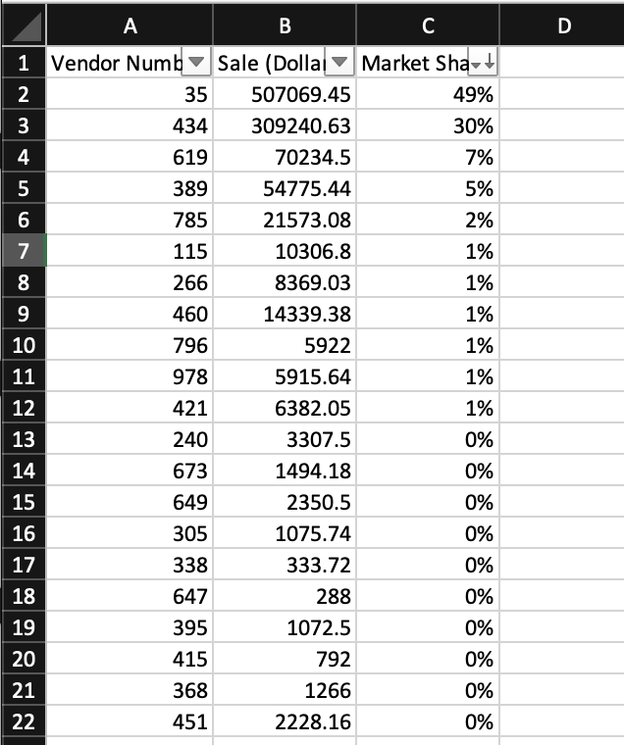
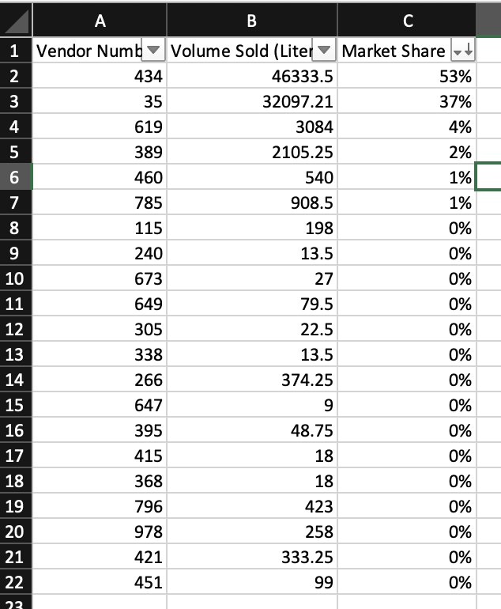
Market Share Dollar & Volume(L)

Slide 31
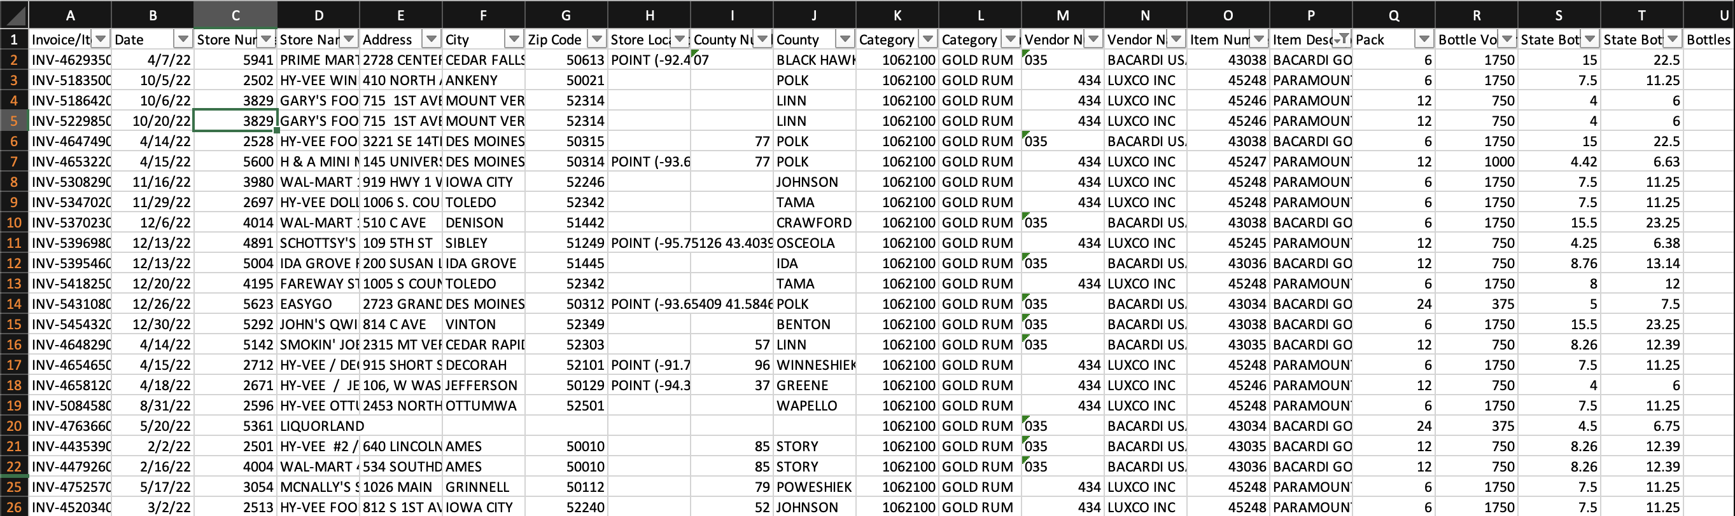
Gold Rum Sales Data Dump

Slide 32
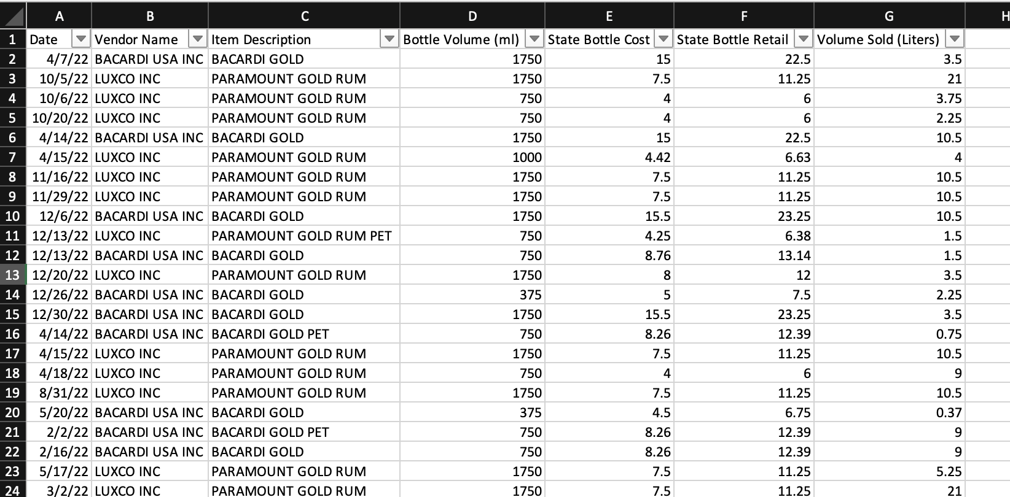
Data Fields Used for regression

Slide 33
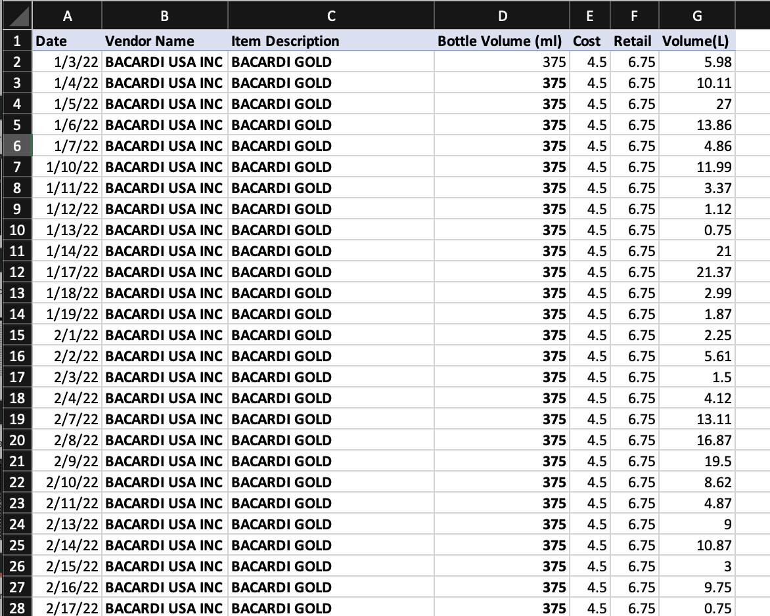
Data aggregated at daily level for regression

Slide 34
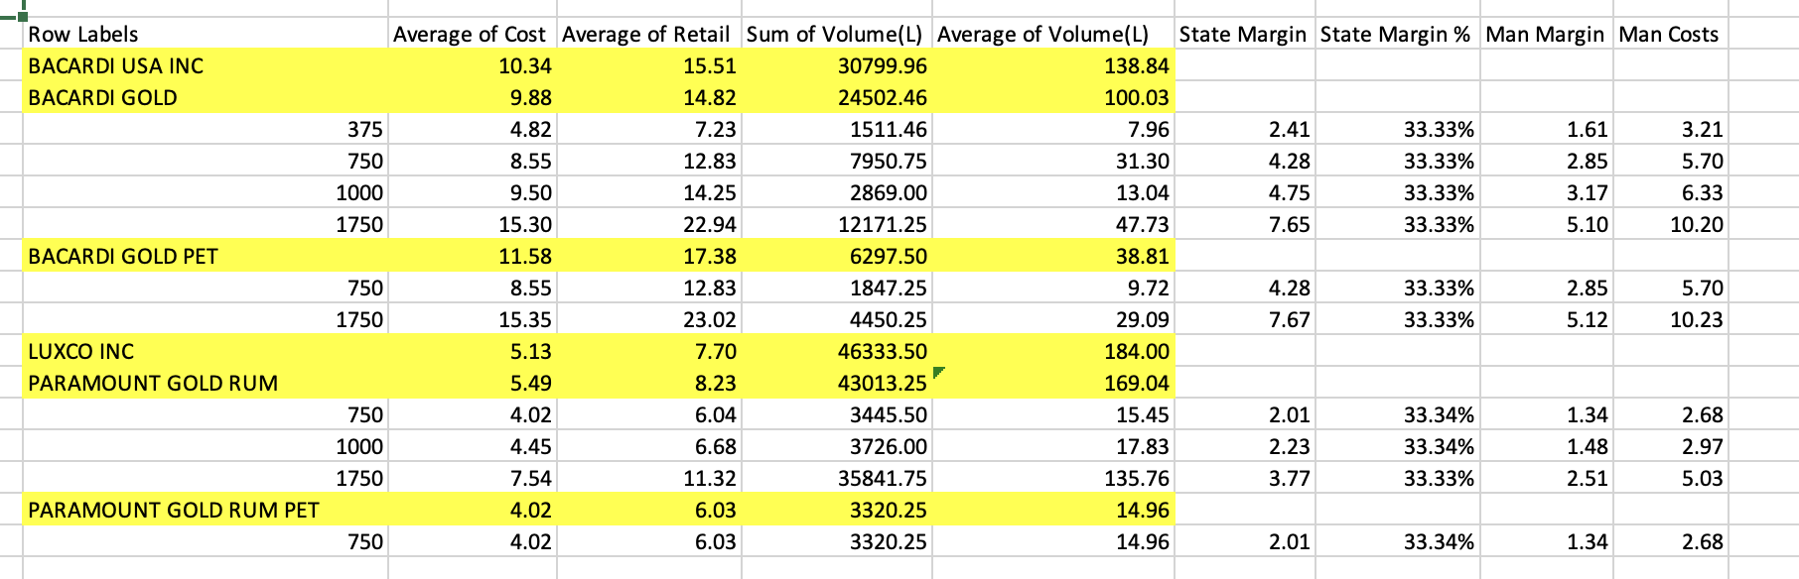
Margin Calculation

Slide 35
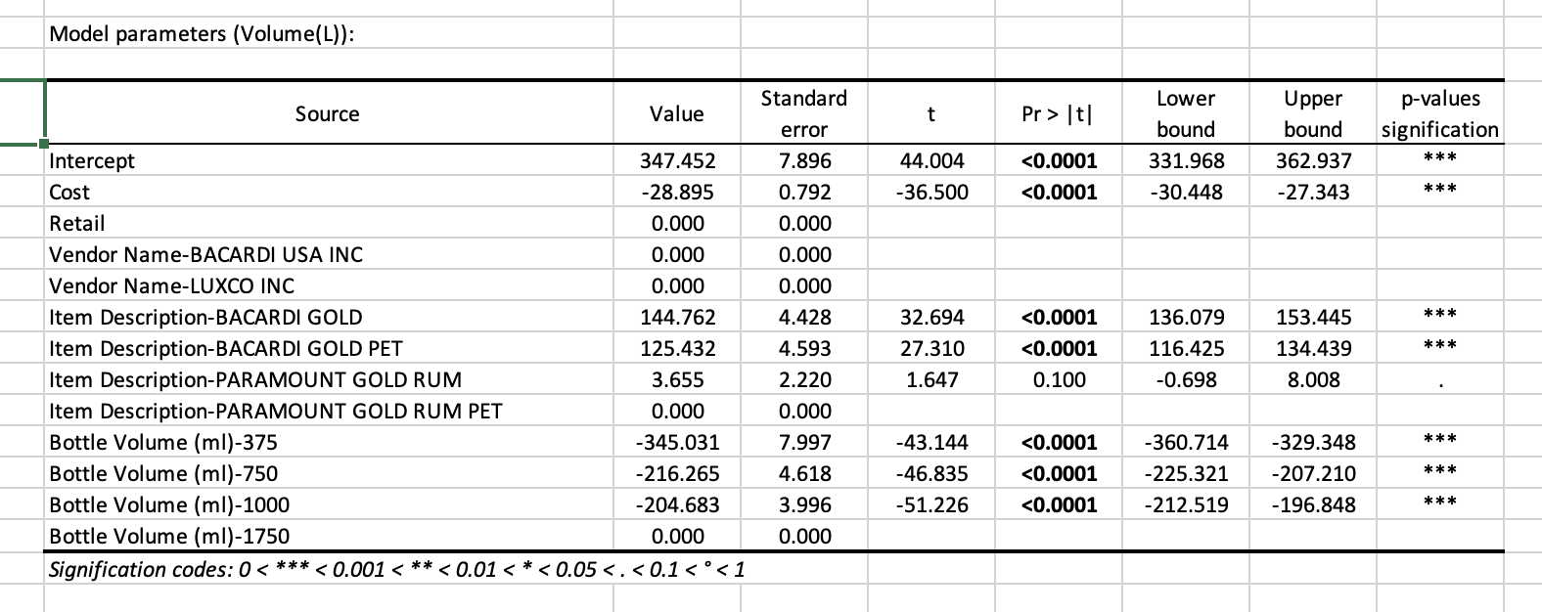
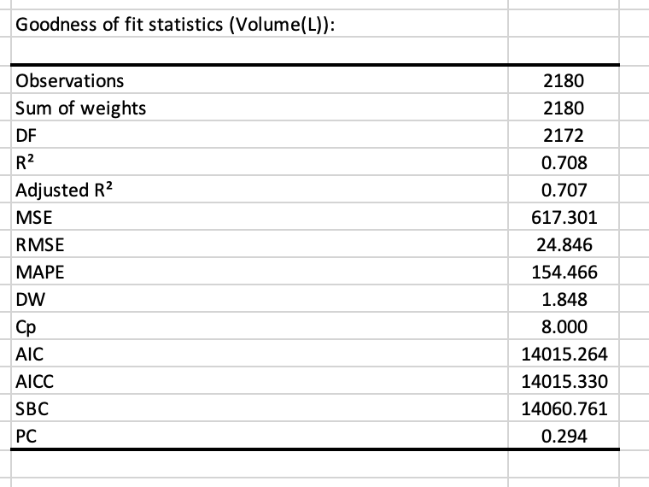
Regression Output

Slide 36
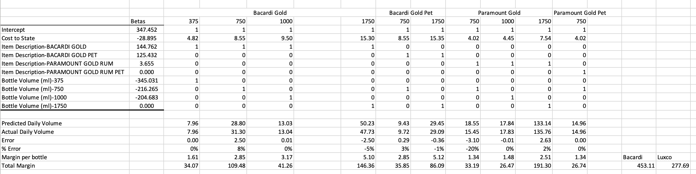
Prediction without Discount

Slide 37
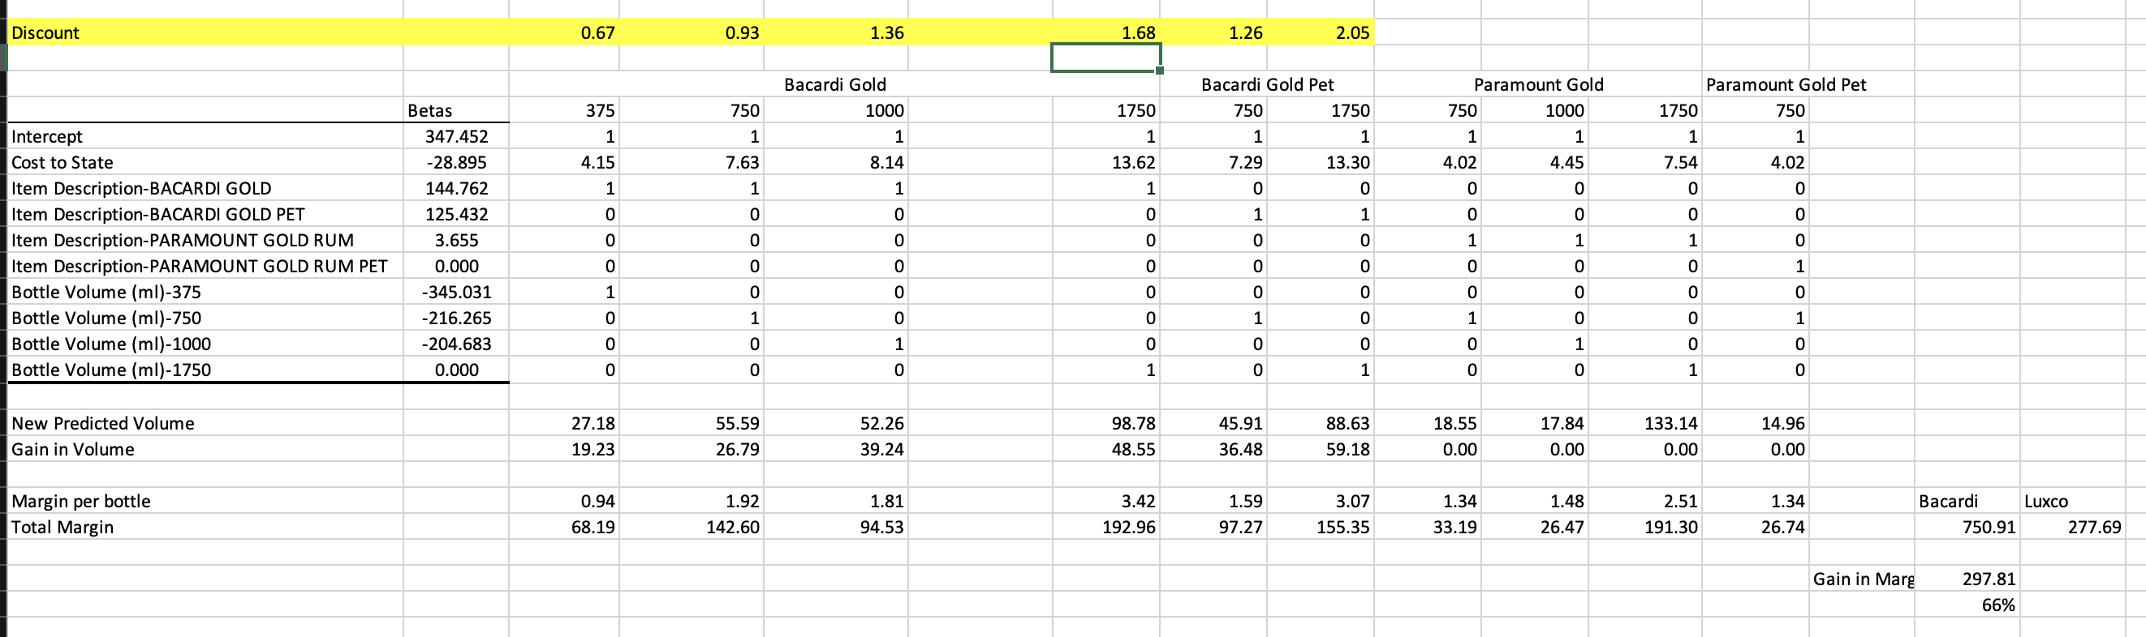
Prediction With Discount

Slide 38
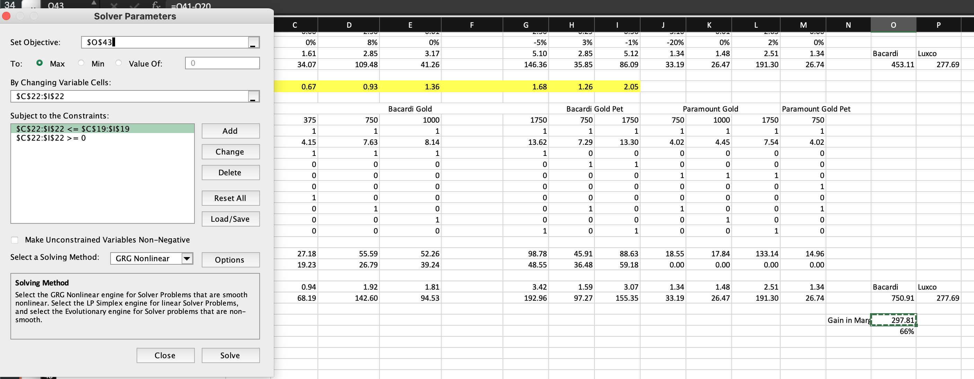
Optimizer

Slide 39
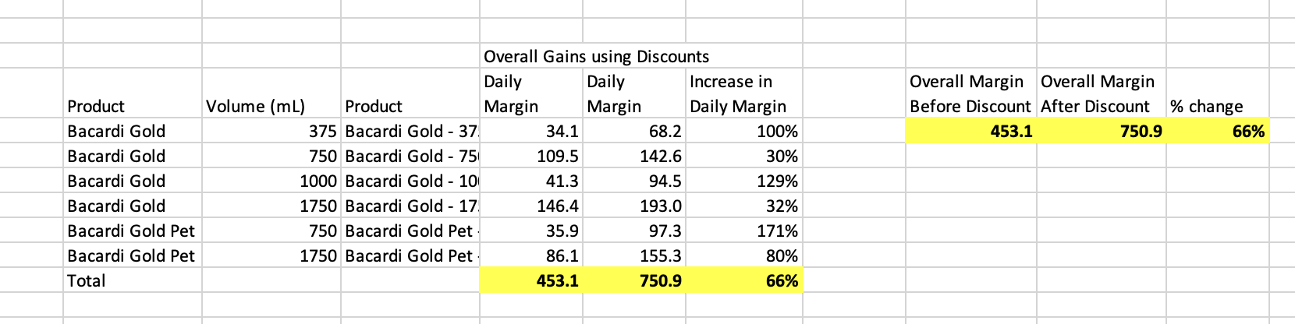
Margin change Calculations

